Slide 1
GSP 2206: Theories of Peace Studies and Conflict Resolution By Abdulmalik Auwal Ph.D Dept. of Political Science Bayero University, P.M.B. 3011, Kano. Email: amauwal1969@yahoo.com Phone: 08023210838; 08033477182

Slide 2
Introduction I
Since the end of the Cold War, the aftermath of the September 9/11 attack on the USA and the intensification of conflict in the Gulf region led to the rise of the Islamic State of Syria and Iraq (ISIS), the world has been in turbulence.
In Africa, this scholarly interest was informed by the experience of the Rwanda genocide of 1994, Liberia and Sierra Leone’s civil wars of the 1990s, the rise of militia and Islamists extremists as well as the dotted spots of political, ethno-religious and environmental conflicts.

Slide 3
Introduction II
In Nigeria, since the return to democracy in 1999, there has been an increase in the number and spots of conflict in Nigeria.
These conflicts include ethno-religious conflicts, farmers-pastoralist violence, kidnapping, the Niger-Delta squabble, electoral misconduct and violence, land disputes, secession threats and more recently the Boko-Haram insurgency, which has threatened the foundational survival of the country.

Slide 4


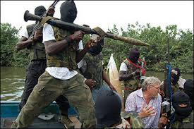

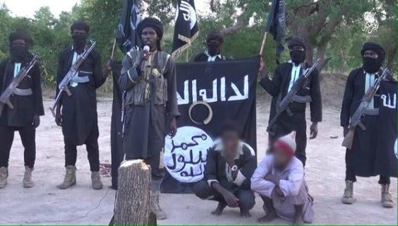

Slide 5
Basic Concepts in Peace Studies and Conflict Resolution
Theory:
A theory, according to Faleti (2006) is an idea or belief about something arrived at through assumption and in some cases a set of facts, propositions, or principles analyzed in their relation to one another and used, especially in science, to explain phenomena.
It must also have explanatory, predictive, and problem-solving value.
Cohen (1968:2) posits that “the goal of any theory is to explain something which has occurred with a view to dealing with problems which arose or may arise as a result”.

Slide 6
Peace
According to Miriam and Casmir (2009), peace is one of humanity’s highest values.
It is a state of mind in concourse with serenity: a state of harmony, tranquility, concord and a balance of equilibrium of powers.
Peace is the opposite of conflict; it abhors violence and war. It is also a state of justice, goodness and civil government.
Peace is not a finished condition but always a work in progress.

Slide 7
Conflict
Conflict is considered to be a product of disagreement that is rooted in the belief system and perceptions of threat to peoples' goal attainment.
To Chaplin, conflict is "the simultaneous occurrence of two or more mutually antagonistic impulse or motives".
Coser (1967:61) sees conflict as a “process; thus the struggle over values and claim to scarce resources, status and power in which the aims of the opponent is to neutralize, injure or eliminate their rivals”.

Slide 8
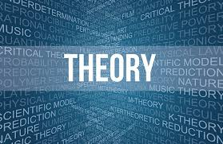



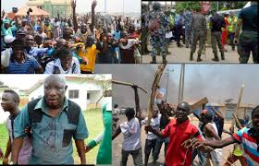
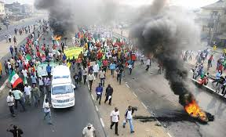

Slide 9
Theories of Peace and Conflict Resolution
This chapter explains the theories with a view to providing frameworks of understanding the causes, patterns and dynamics of conflict in societies.
Social Conflict Theories:
Karl Marx (1818-1883) is, without doubt, the celebrated father of modern social conflict thinking in the social sciences.
It is a Marxist-based theory which argues that individuals and groups (social classes) within society interact on the basis of conflict rather than consensus.

Slide 10
Social Conflict Theories
Edlyne (2009), is of the opinion that social conflict theories are anchored on the need of the social scientist to understand, explain and predict the social world.
George (1958) also sees social conflict as representing a universal form of interaction in which groups are naturally in conflict as their purposes and interest/goals overlap, encroach on each other and often tend to be competitive.

Slide 11
Social Conflict Theories
Edlyne (2009) sees society as existing in continuous struggle or friction between different groups. The conflict assumes that social behaviour is best understood in terms of conflict or tension between competing groups. Such conflict need not be violent, it can take the form of labour negotiations; party politics; competition among religious groups for members, or disputes over cuts in the federal budget.
This simply implies that social conflict theories view social life basically as characterized by conflict which take various forms and are expressed in divergent ways.

Slide 12
Social Conflict Theories
Generally, conflict may arise over access to valued and scarce resources (economic, political and social) in society; difference in opinion or perspective; prejudice and discrimination; belief systems, etc.
It is the suggestion of social conflict theories that the powerful and wealthy in the upper class of society define what is right and what is wrong; the rich and mighty people can behave like “robber barons” because they make the laws and control law enforcement (Elena and Petter, 2015).

Slide 13
Social Conflict Theories
The theory explains the conflict of social classes; bourgeoisie vs proletariat, the economics of scarce resources that are responsible for orderly and disorderly actions of citizens in a country or state and in ideologies, such as capitalism, which considers that societies and organizations function, so that each individual and group play a specific role (Ogunbameru, 2008).
Conflict theorists examine the tensions between dominant and disadvantaged groups within society and seek to understand how relationships of control are established and perpetuated.

Slide 14
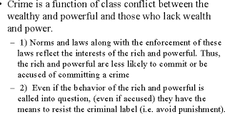
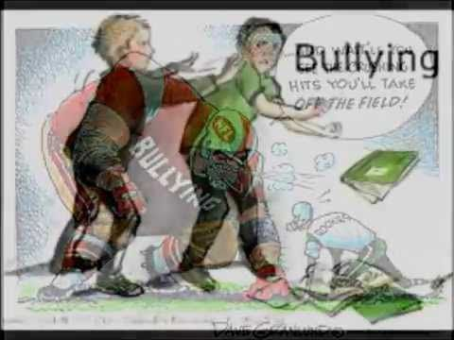

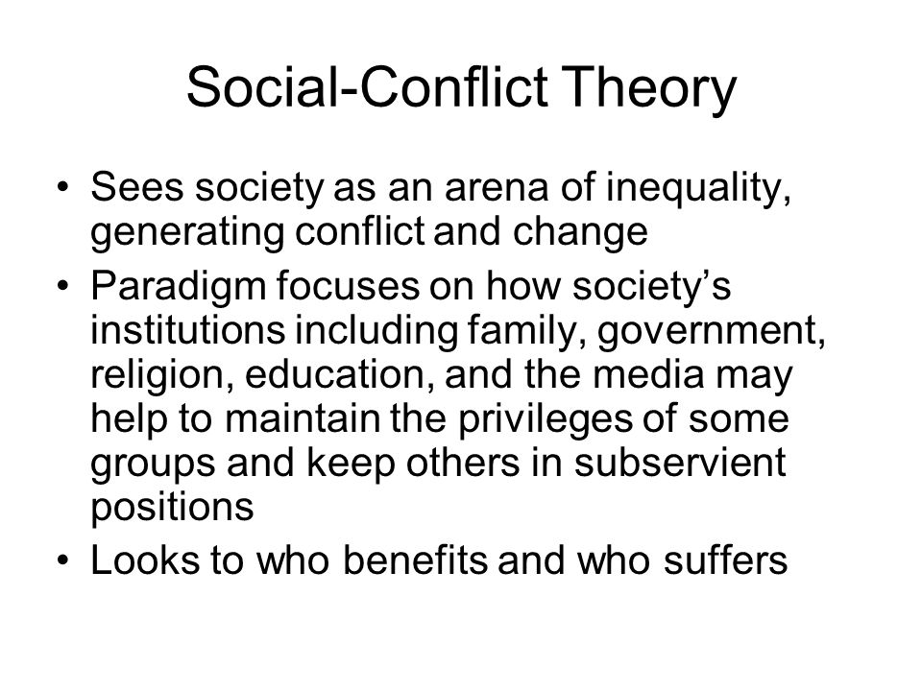
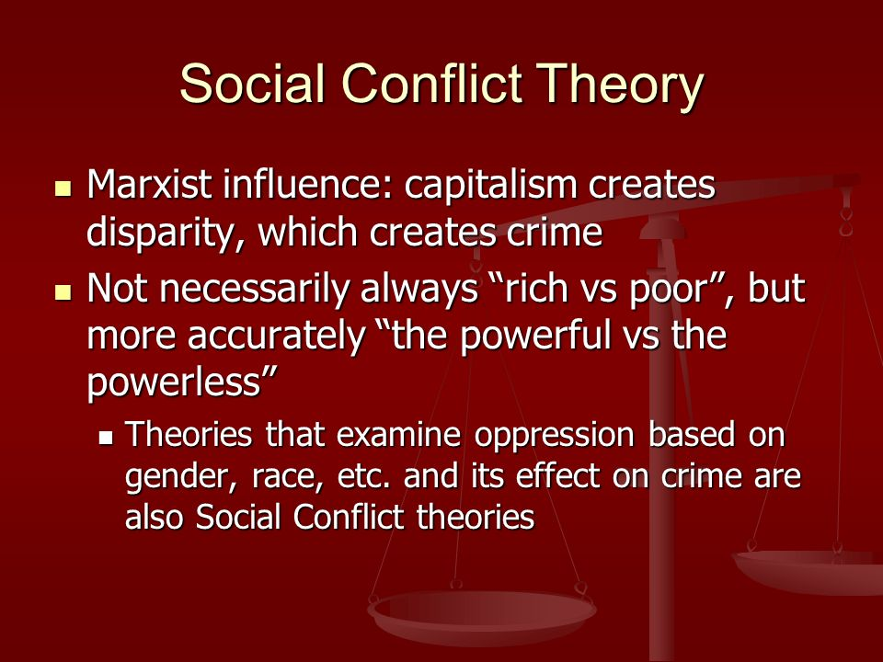

Slide 15
Social Conflict Theories
To resolve a conflict or avert violence that arises as a result of marginalization, domination and exploitative economic relationships in capitalist societies, there’s need for a radical transformation in the pattern of global economic relations or a revolution that will bring about systemic change from capitalism to socialism.
Structural Theory of Conflict
The structural conflict theorists argue that conflict occurs in society as a result of structural flaws and imbalances.
The theory has two main perspectives namely the Radical Structural Conflict Theory and the Liberal Structural Conflict Theory.

Slide 16
Structural Theory of Conflict
The Radical Structural conflict theory is advocated by Marxist school of thought with promoters like Marx and Engel, Vladimir Lenin, Mao Tse Tung, etc., while
The Liberal Structural conflict theory is advocated by Johan Galtung, Scarborough, Ross, etc.
The main argument of the structural conflict theory is that conflict is built into the particular ways societies are structured and organized (Faleti, 2006).
The theory examines social problems like political and economic exclusion, injustice, poverty, disease, exploitation, inequity, etc., as sources of conflict.

Slide 17
Structural Theory of Conflict
Structuralist argue that conflicts occur because of the exploitative and unjust nature of human societies; the domination of one class by another, etc.
The radical structural conflict theorists blame capitalism for being an exploitative system based on its relations of production and the division of society into the proletariat and the bourgeoisie.
The exploitation of the proletariat and lower classes under capitalism creates conflict. Thus, capitalist societies are accused of being exploitative, and such exploitation is a cause of conflict.

Slide 18
Structural Theory of Conflict
Structural conflict theorists further argue that in an attempt to explain the reason behind the underdevelopment of the ‘third world countries’, the dependency theorists accuse the ‘world capitalist system’ as an imperialist system that is structurally exploitative and retards the development of the third world countries.
The liberal perspective argue that whenever economic and political discrimination and lack of tolerance in plural societies are embedded in human social relationship, conflicts are bound to be higher than in societies where the opposite social relationship is established.

Slide 19
Structural Theory of Conflict
Similarly, the structuralist argue that other factors such as overpopulation, economic underdevelopment, demographic factors, and uninterested social and political institutions are also responsible for the emergence of internal conflicts.
To resolve conflict or avert violence in a radical perspective, Marxists suggest a revolutionary means or a radical transformation that will change the exploitative economic relations and entrench a socialist system while the Liberal structuralist on the other hand call for the elimination of structural defects with policy reforms.

Slide 20
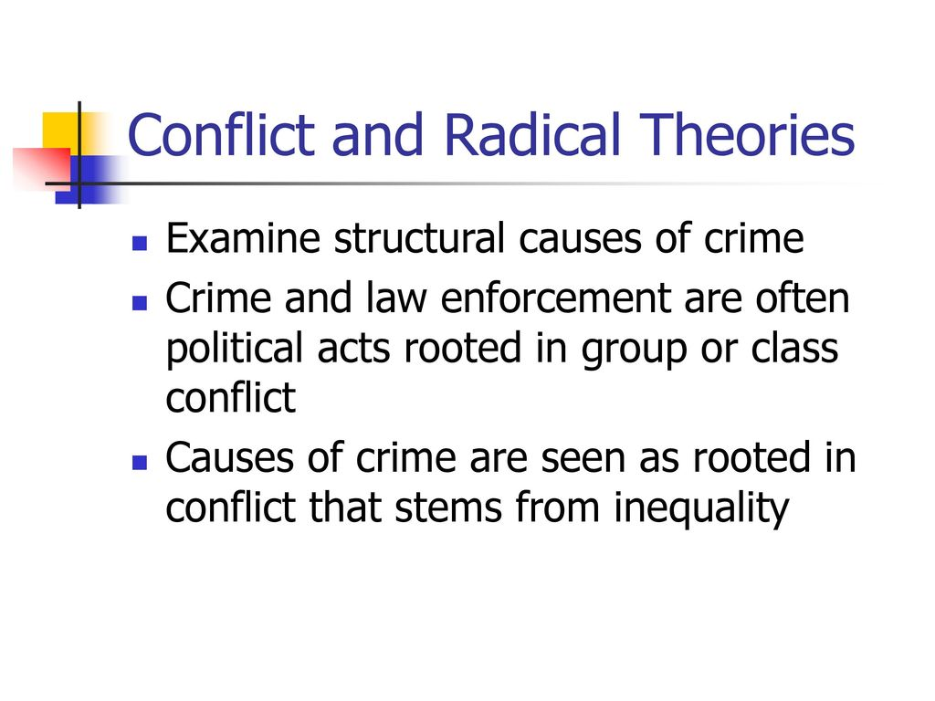
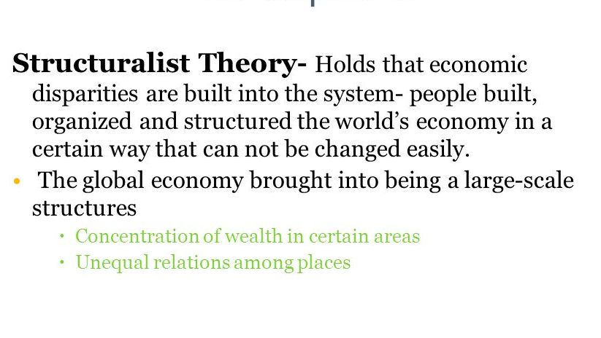

Slide 21
Biological Theory of Conflict
The essential position of Biological conflict theory is that man (by nature) has the tendency to do evil and express unfavourable circumstances in a violent manner.
The theory further explains that human nature is genetically transferred from generation to generation.
Just as parents can genetically transfer their godly qualities and ingenuity to their children, so can the evil nature of man be genetically transferred (Folarin, 2013).

Slide 22
Biological Theory of Conflict
Classical theorists like Thomas Hobbes, St. Augustine, Thomas Malthus, and Sigmund Freud, identified the intrinsic tendency of man to be selfish, sinful, and driven by the natural quest for the ceaseless pursuit of power as the main reasons why conflicts occur and continue to rise in human society.
Theologians such as St. Augustine posits that religion plays an important role in regulating the sinful impulse in man, and to Hobbes, conflict could be averted when different individuals in pursuit of selfish interests, in a ‘state of nature’ (where life is solitary, poor, nasty, brutish and short), agree to surrender their ‘will’ (natural rights) to a Leviathan (a sovereign) by confession to ones’ sin, seeking for forgiveness and healing traumatized people.

Slide 23
Relative Deprivation and Frustration-Aggression Theory
It is psychologically believe that man, naturally react to unpleasant situations.
The theory is propounded by Dollard and Doob, et al (1939), and further developed by Miller (1948) and Berkowitz (1969).
These theorists are of the view that conflict occurs due to relative deprivation and frustration-aggression tendencies.
According to Horowitz (2001:7) “relative deprivation is define as actors’ perception of discrepancy between their value expectations and their value capabilities; that is, the discrepancy between what people think they ought to get from society and what they believe they will actually obtain”.

Slide 24
Relative Deprivation and Frustration-Aggression Theory
Thus, the primary focus of relative deprivation theory is the political and economic conditions that produce discontent with the political opportunity theories focusing on the relationship between political structures, the distribution of political power and collective action.
Frustration, on the other hand, is described as the feeling we get when we do not get what we want, or when something interferes with our gaining a desired goal, as portrayed in the case of Niger Delta or the Nigerian civil war.
Anger implies feeling mad in response to frustration or injury; while aggression refers to flashes of temper (Tucker-Lad, 2013).

Slide 25
Relative Deprivation and Frustration-Aggression Theory
The frustration-aggression theory states that aggression is caused by frustration. When someone is prevented from reaching his target, he becomes frustrated. This frustration can then turn into anger and then aggression when something triggers it (Folarin, 2013).
Gurr (1970:33) distinctively captures this view in the following words:
“Frustration’ is an interference with goal-directed behaviour, ‘aggression’ is behaviour designed to injure, physically or otherwise, those toward whom it is directed. The disposition to respond aggressively when frustrated is part of man’s biological make-up; there is a biological inherent tendency, in men and animals to attack the frustrating agent which in turn, is ‘an outgrowth of stimulus-response psychology”.

Slide 26
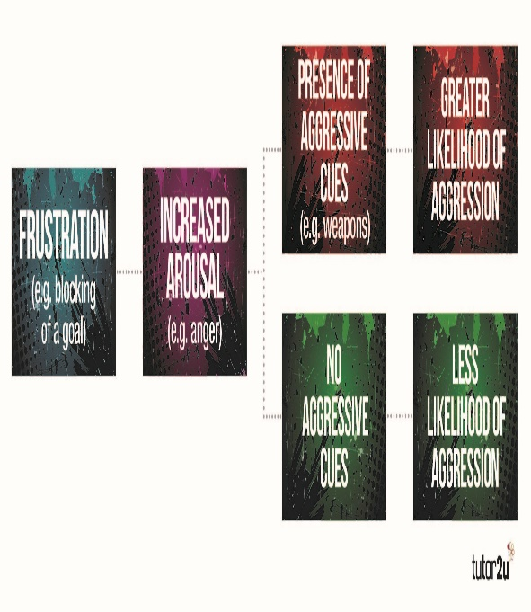
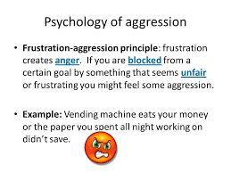
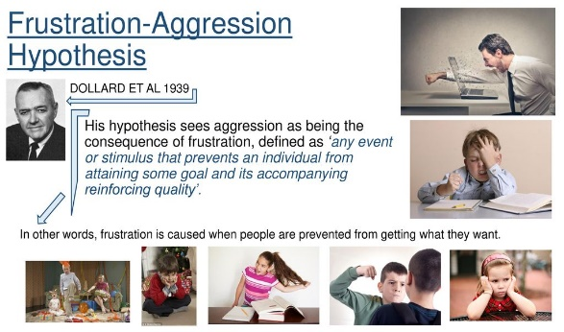

Slide 27
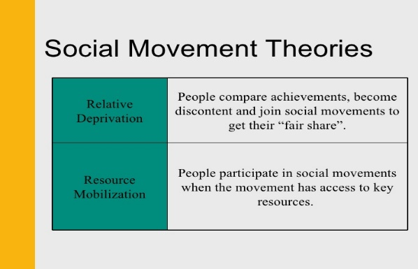
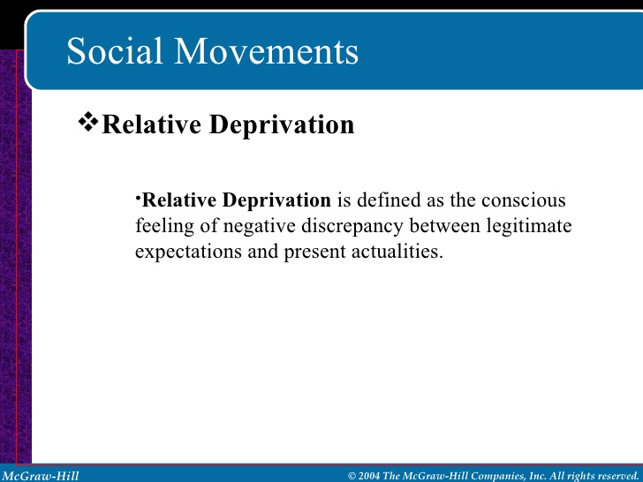
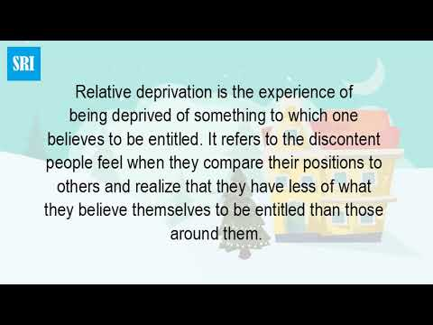
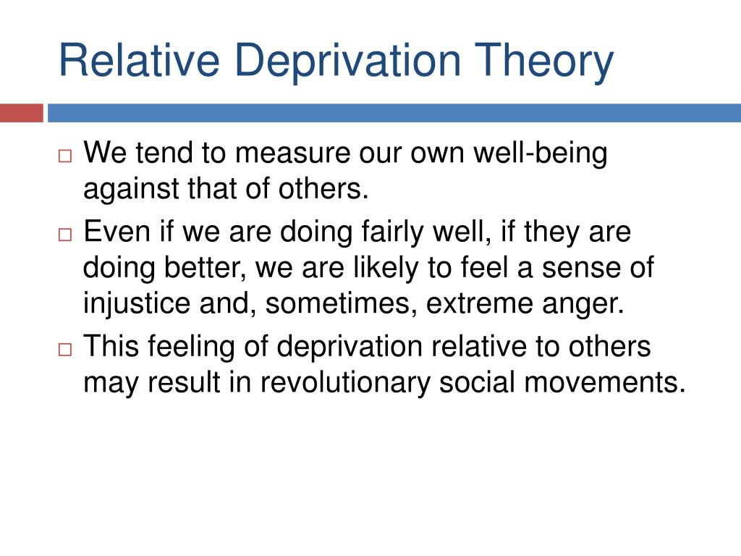

Slide 28
Human Needs Theory
The position of human needs theory is similar to that of Frustration-Aggression and Relative Deprivation theory. In order to live and attain well-being, humans need certain essentials (needs for food, clothing shelter, survival, protection, affection, recognition, understanding and autonomy).
Human needs theorists argue that conflicts and violent conflicts are caused by unfulfilled human needs.
Violence occurs when certain individuals or groups are denied or frustrated from achieving their basic needs or do not see any other way to meet their need.

Slide 29
Human Needs Theory
As Coate and Rosati (1998: ix) observe, human needs are a powerful source of explanation of human behavior and social interaction.
All individuals have needs that they strive to satisfy, either by using the system, 'acting on the fringes, or acting as a reformist or revolutionary.
Given this condition, social systems must be responsive to individual needs, or be subject to instability and forced change (possibly through violence or conflict).
Hence, Infective and easily accessible 'satisfiers' are to be provided by the state in order to prevent conflict. In most African states where the state institutions no longer supply adequate public goods, as a result of structural and systemic economic crises, conflict has been the case.

Slide 30
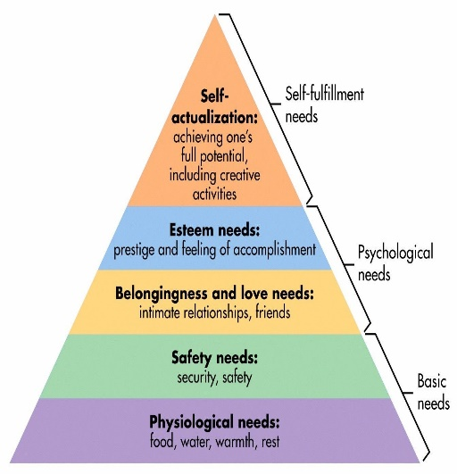
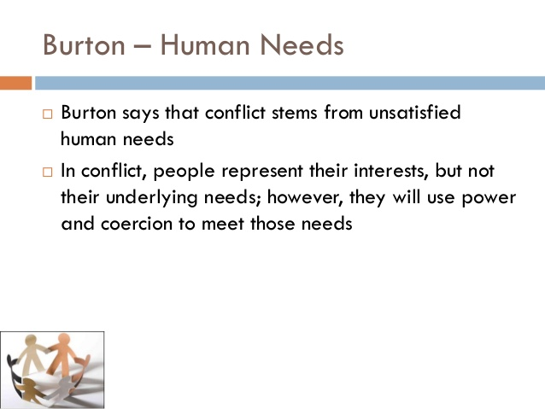
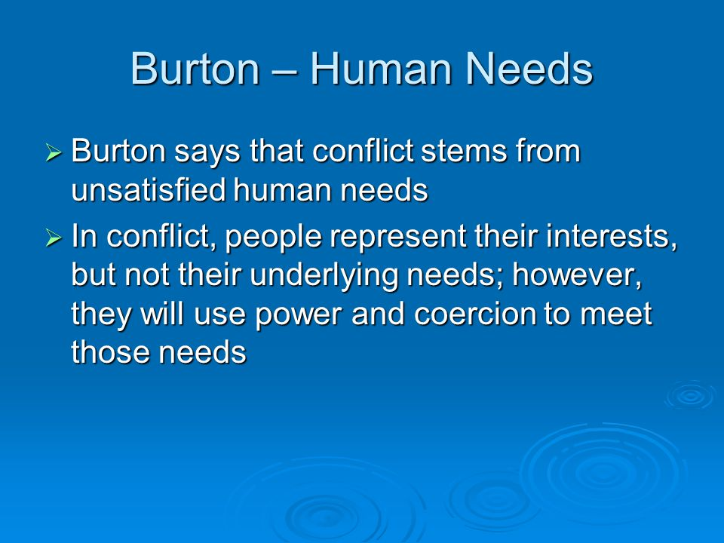
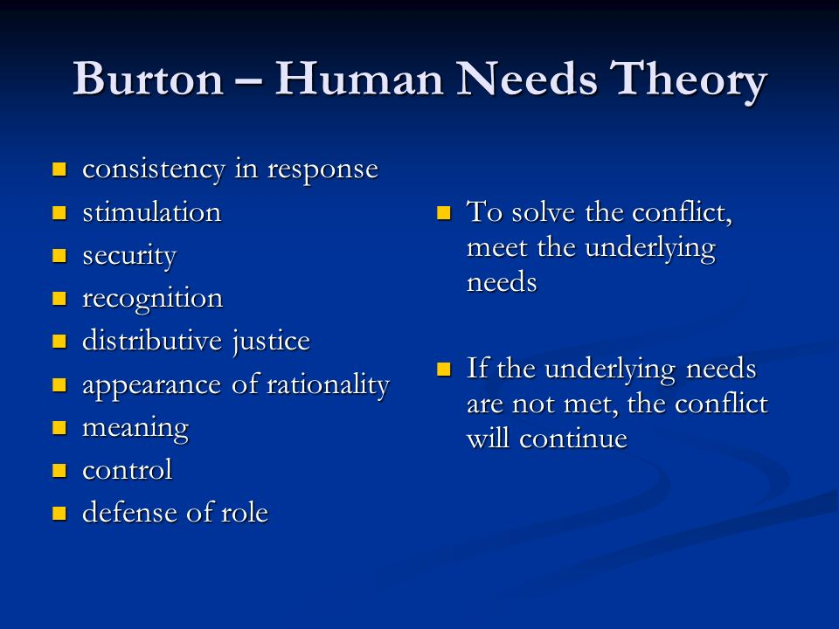

Slide 31
Economic Theories of Conflict
Economists attempt to explain the occurrence of conflict in human society through economic explanations and basically see humans as rational beings that have the tendency to fight over things that are material (Faleti, 2006).
The greed thesis sees conflict in society as resulting from human greed and the desire of some people, called conflict entrepreneurs, to benefit from conflict that propels them to go to war (Collier, 2006).
Collier gives the example of a rebel group in a country, which uses grievance as a bait to go to war in order to gain economic benefits

Slide 32
Economic Theories of Conflict
Collier argues that conflicts are perpetrated by those who benefit from chaos (referred to as ‘conflict entrepreneurs’), who not only steer conflict but also invest resources at their disposal to ensure that conflict lingers on for maximization of material benefits.
In most cases, conflict and its prolongation have become a private business making enterprise where the sole aim of perpetrators is profit making or its maximization.

Slide 33
Psycho-Cultural Theory of Conflict
The psycho-cultural theory of conflict emphasizes the role of culturally induced conflicts; it shows how enemy images are created from deep-seated attitudes about human action that are learned from early stages of growth in the explanation of conflict (Ross, 1993:18).
Like the human needs theory, when ones’ identity (ethnicity and culture) is discriminated against or denied, it produces strong feelings of hatred, resentment and results to violent conflict; for instance, the Hutu and Tutsi in Rwanda; the ‘indigenes/settlers’ conflict in Plateau State, Nigeria.

Slide 34
Psycho-Cultural Theory of Conflict
The theory argues that conflicts which are caused by identity are usually dangerous, violent, intractable and highly protracted, and often very difficult to resolve.
When the feeling of safety (identity) is threatened, there is a defensive reaction aiming at protecting it at all costs and the result is violent conflict which becomes a matter of life and death.
The theorists further argue that resolving this type of conflict is usually very difficult and tends to defy any resolution mechanism.

Slide 35
Psycho-Cultural Theory of Conflict
There is always constant outbreak of violence with such conflicts despite attempts at resolving the conflict. Their resolution takes long and sometimes, it is not possible to talk of resolution, but management.
This is because the issue of ethnic identity is uncompromising and its denial is a complete affront to the groups’ very existence.
To resolve a conflict of this nature, the theorists argues that tolerance and understanding among people and groups of different races, cultures, languages and historians are established.

Slide 36
Realist Theory of Conflict
Since politics is the struggle for power, then, “competitive processes” between actors, primarily defined as states, is the natural expression of conflict by parties engaged in the pursuit of scarce and competitive interests (Deutsch, 1973).
Realist theorists include Carr (1939), Herz (1951), Morgenthau (1973), their perspective is anchored on the assumption that human nature is ‘bad’, sinful and wicked (Kegley and Wittkopf, 1989), and individuals and states engaged in the pursuit of personalized self-interest defined as power.

Slide 37
Realist Theory of Conflict
There are two levels of the Realist view of conflict in human society. At the heart of its tools of analysis, each paradigm combines some aspects of Hobbesian, biological and theological doctrines in order to explain the behaviour of actors in competitive power relations.
The first level is the understanding of international system as anarchic and, according to the ardent proponent of this theory (Morgenthau, Haas, Clausewitz and Nebuer) a terrain of incompatible interests creates room for discord and conflict.

Slide 38
Realist Theory of Conflict
The latter is seen as the result of insatiable quest for self fulfillment of national interest by one or more actors which also go contrary to those of other actors.
The second perspective and indeed the starting point of realist analysis of conflict is the individual understanding of human nature.
This view conceives individual interest as the prime mover of conflict because there is an apparent weakness and individualism inherent in human nature that tends to make an individual self-centered, avaricious, and thus naturally inclined to conflict.

Slide 39
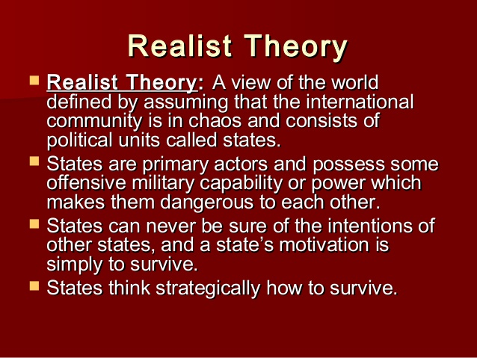
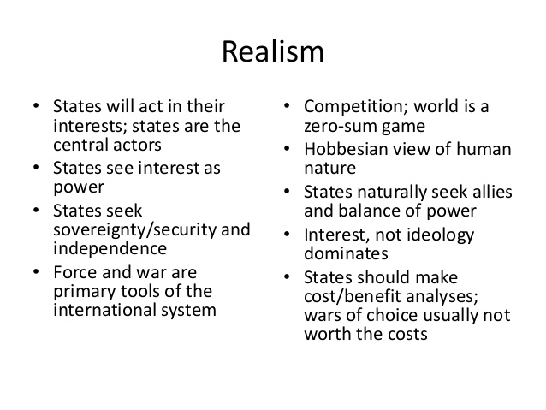


Slide 40
Contentious Tactics
This theory according to Pruitt and Kim (2004) seeks to impose its preferred solution on others. This usually involves persuading or forcing other to yield.
Things that party does to dominate other using the following tactics are: ingratiation, promises, and persuasive argumentation, to shaming, tit-for-tat, and threats, to coercive commitment and various forms of violence.
These tactics are guided by the following assumptions.

Slide 41
Contentious Tactics
First, there is nothing inherently destructive or baleful about contentious tactics other than violence. Rather, it is the end to which these tactics are used that can render them harmful.
For example, although threats are most easily conceived of as instruments of destruction or malevolence, they may also be used to signal party’s unwillingness or inability to bend beyond some critical point in a generally collaborative arrangement.
Similarly, coercive commitments can be used not only in the service of imposing party’s will on other but to signal party’s determination to keep the relationship together, under even the most difficult circumstances. In short, most contentious can be used to advance the interest of collaboration as well as to defeat other.
Secondly, contentious tactics are also assume to differ along a dimension of ‘light-heaviness’.

Slide 42
Contentious Tactics
“Light tactics” is defined as those whose consequences for other are favourable or neutral while “heavy tactics” impose, or threaten to impose, unfavourable or costly consequences on other. For example, promises are lighter than threats, and threats are heavier than promises and lighter than violence.
Thirdly, contentious tactics are more often than not deployed in an escalative sequence, moving from light to progressively heavier because ‘lighter tactics’ are typically less costly for party than ‘heavier’ ones. The transition from light to heavy implies that party has tried to prevail by utilising carrots and has been dragged only reluctantly into the use of stick as a result of other’s intransigence. The light-to-heavy shift thus permits party to blame its own contentious behaviour on other.

Slide 43
Contentious Tactics
The Sequence of Light-to-Heavy Tactics:
Light =============== Has Favourable Consequences [Ingratiation and Promises]
Relatively Heavier ===== Adopts [Persuasive Argumentation and Shaming]
Heavy ============== Imposes [Threats and Coercive Commitment]
From the above presentation, both ingratiation and promises tactics constitute relatively light weight maneuvers designed to make subsequent moves more effective.

Slide 44
Contentious Tactics
For example, exaggerating on other’s admirable qualities while soft-pedaling other’s weakness (telling your woman she’s beautiful and sensitive or a subordinate heaps praises on his boss, giving favours or presenting yourself appropriately attractive, etc) while promises are messages from party announcing its intention to reward other if other complies with party’s wishes (offer something that is presumed to be attractive to other in exchange for other’s compliance). Persuasive argumentation and shaming on the other hand are relatively heavier tactics.
Persuasion is used here as a technique to induce other to lower its aspiration through a series of logical appeals (persuading labourers/workers to accept pay cuts/layoffs in order to save a business {corporate survival}) while shaming is usually achieved by publicizing other’s defects or transgressions.
Threats and coercive commitment are heavier tactics that imposes, or threaten to impose unfavourable or costly consequences on others.

Slide 45
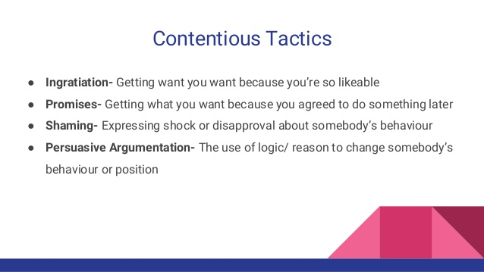
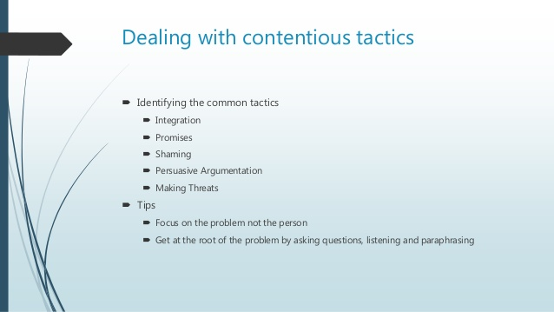
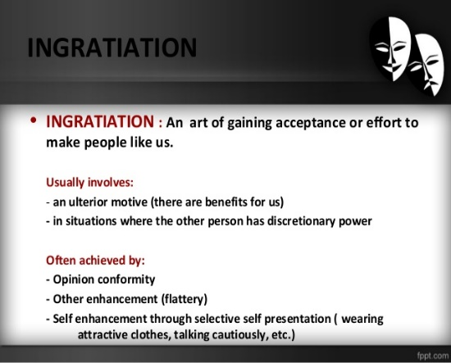
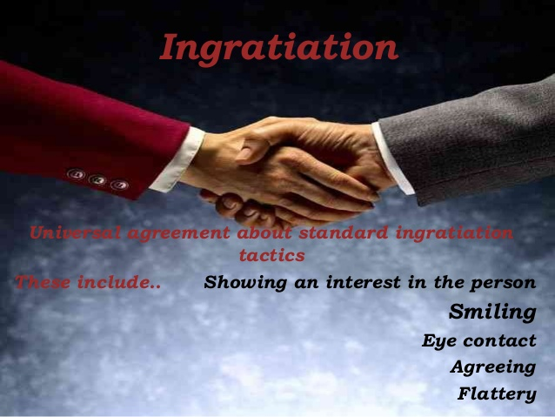
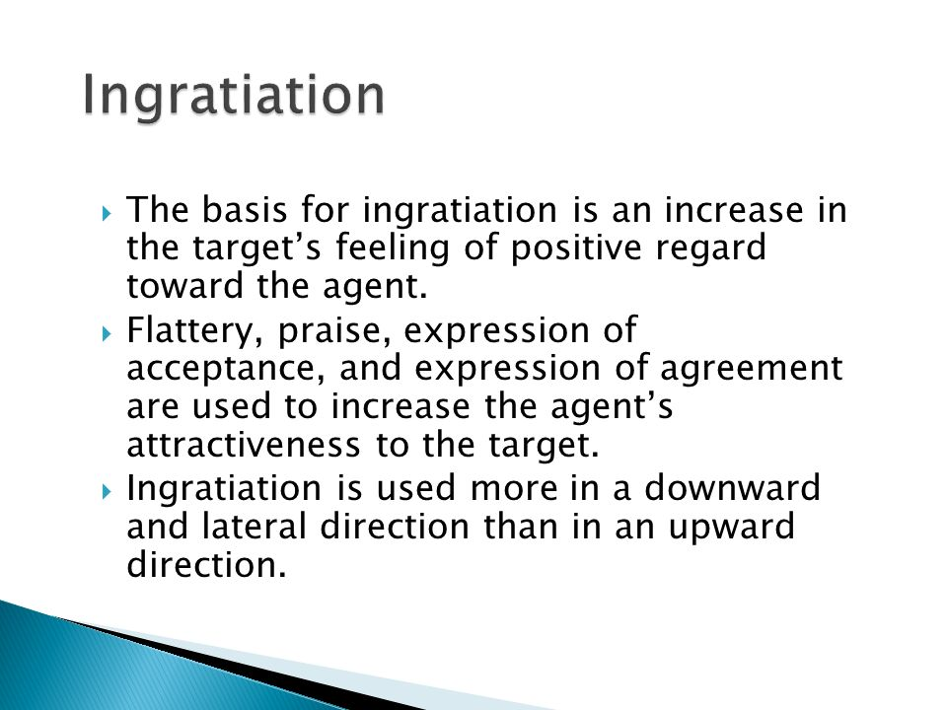

Slide 46



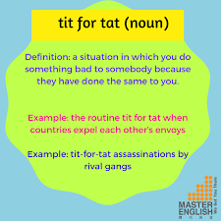
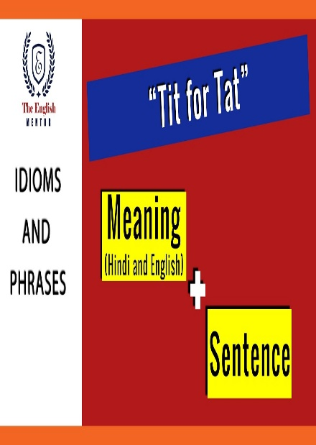
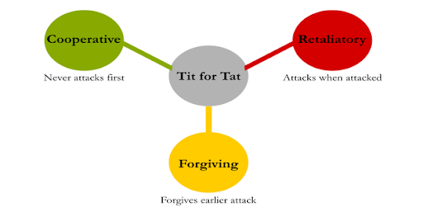


Slide 47
References
Cohen, P. S. (1968), Modern Social Theory, London: Heinemann
Coser, L. (1956), The Functions of Social Conflicts, Published by London, Free Press.
Edlyne, E. A. (2009), Theories of Social Conflict, in Miriam, I. (ed.), Peace Studies and Conflict Resolution in Nigeria: A Reader, Spectrum Books Ltd., Ibadan
Faleti, S. A. (2006), Theories of Social Contract, in Shedrack, G B. (ed.), Introduction to Peace and Conflict Studies in West Africa: A Reader, Spectrum Books Ltd, Ibadan.
Gurr, T. R. (1970), Why Men Rebel, Princeton University Press, New Jersey

